Slide 1
S molaba

Slide 2
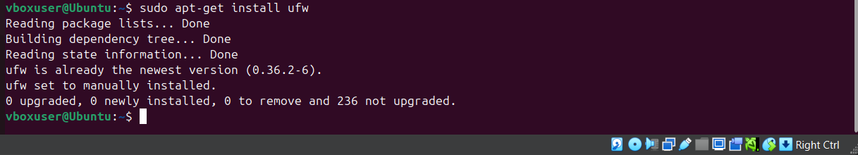
PART 1:Create a firewall using iptables or Ufw
OBJECTIVE:
to control and secure network traffic on a system by defining rules that allow or block specific types of connections. The primary objective is to enhance security, control network traffic, network management and protect internal resources using uncomplicated Firewall (uFW).
STEP 1: Install uFW

Slide 3

The command to install uFW does the following:
Sudo - Runs the command with superuser (root) privileges, which is necessary for installing software.
Apt-get – Uses the advanced package tool (apt) to manage packages on systems like Ubuntu.
Install – specifies that you want to install a package.
Ufw – the package name for uncomplicated Firewall, a user-friendly firewall management tool.
The command downloads ufw package from Ubuntu’s official repositories, installs ufw along with any required dependencies.
STEP 2: Enable ufw

Slide 4
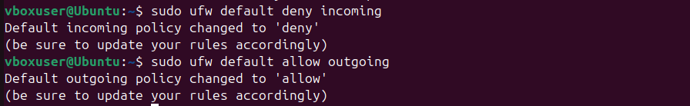
STEP 3: Allow specific ports
Ufw allow – tells the firewall to allow incoming connections.
22/tcp – refers to the port 22 using the TCP protocol, which is commonly used for SSH (Secure Shell) connections
80/tcp – refers to port 80 using the TCP protocol, which is used for HTTP (Web traffic).
STEP 4: Deny all Incoming Traffic (Except allowed rules)

Slide 5
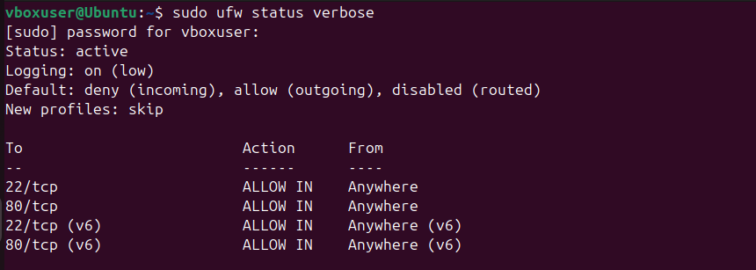
Sudo ufw default deny incoming – Blocks all incoming connections by default. Any connection from outside to your system will be denied unless explicitly allowed.
Sudo ufw default allow outgoing – Permits all outgoing connections by default. Your system can freely send requests to external servers.
STEP 5: Check Firewall status
ufw status – Shows whether the UFW is active or inactive, along with a list of currently allowed or blocked rules.

Slide 6
Verbose – Adds detailed output, including extra information such as default policies, logging status, and active profiles.
PART 2: USING SURICATA OR ANY OTHER TOOL CREATE AN IDS/IPS
OBJECTIVE:
The primary objective is to enhance network security by monitoring and analyzing traffic for potential threats using Suricata, a powerful open-source tool designed for Intrusion Detection Systems (IDS) and Intrusion Prevention Systems (IPS).
STEP 1: Install Suricata

Slide 7


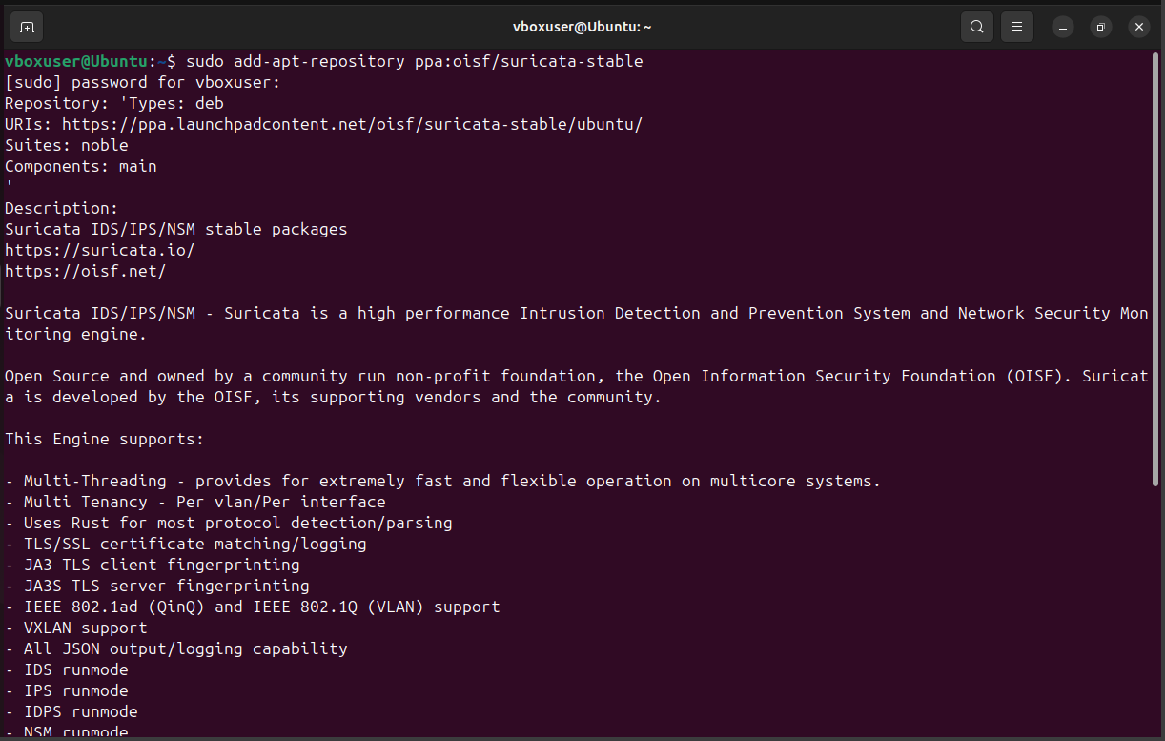
Sudo - Runs the command with administrative privileges.
Add - apt - repository - Adds a new software repository to your system.
Ppa: oisf/suricata - stable - Specifies tha ppa maintained by the Open Information Foundation (OISF), which provides stable Suricata packages.

Slide 8
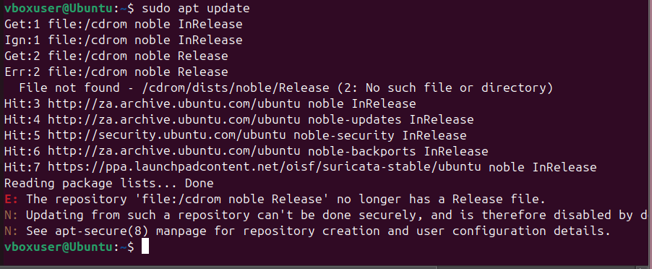
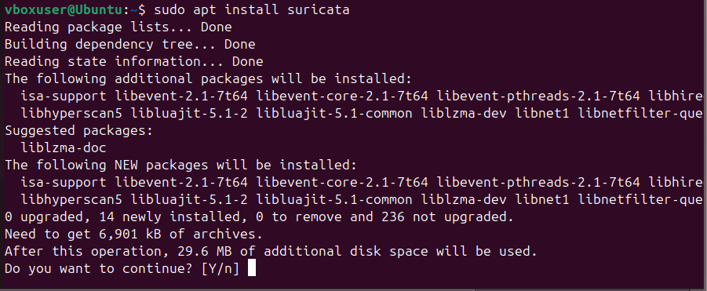
STEP 2 : Update Suricata
STEP 3: Install Suricata

Slide 9
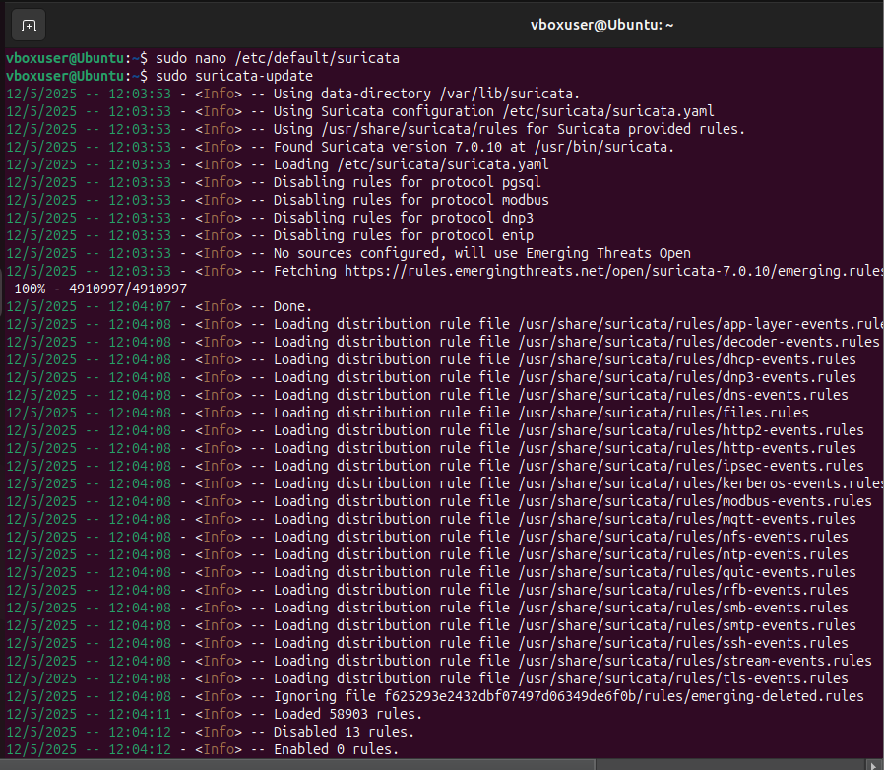
STEP 4: Enable IPS mode
Sed -i –e – Uses sed to edit the files in place.
‘/ATTACK_RESPONSE/ s/^alert/drop/’ – Finds lines containing “ATTACK_RESPONSE” and replaces “alert” with “drop”.
‘/USER_AGENT/ s/^alert/drop/’ – Finds lines containing “USER_AGENTS” and replaces “alert” with “drop”.
/var/lib/suricata/rules/suricata.rules – The file being modified. Effectively, this changes Suricata’s behavior for certain attack response rules.
STEP 5: Start Suricata in IPS mode
-c /etc/suricata/suricata.yaml – Specifies the cocnfiguration file Suricata should use
-q 0 - Tells suricata to use queue 0 for packet processing (used in IPS mode).
STEP 6: Download and update Suricata rules
suricata – update – Manually updates the rules

Slide 10
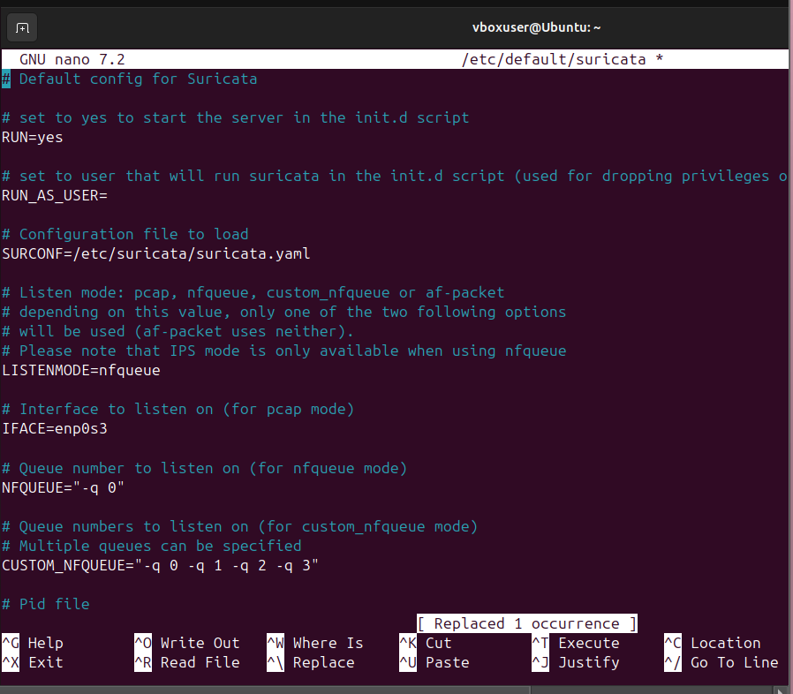
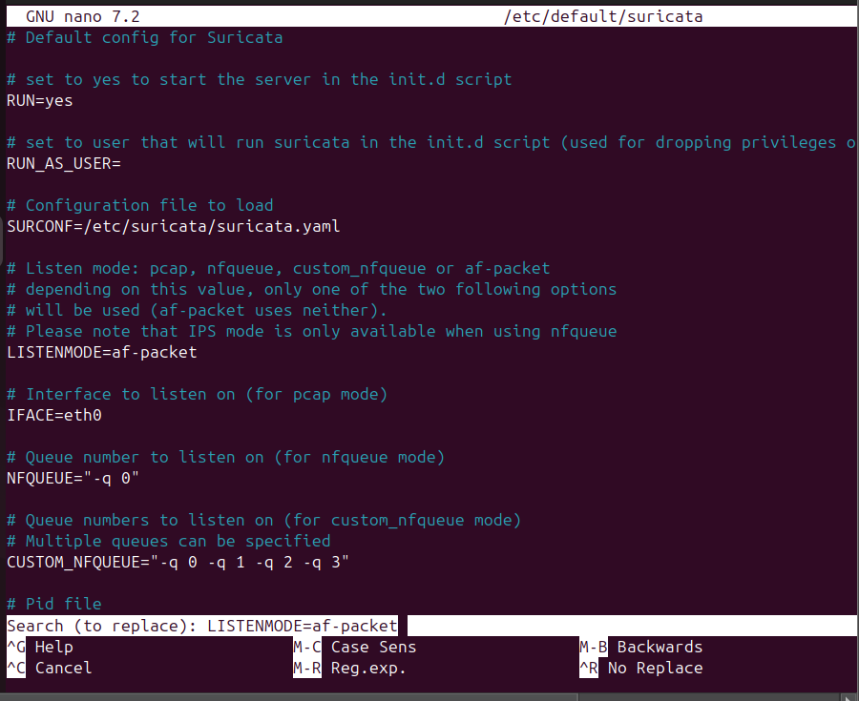
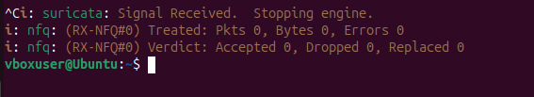
STEP 7: Edit Suricata files
Nano - Launches the Nano text editor (user-friendly text editor).
/etc/default/suricata - This file contains Suricata's default startup settings, such as network interfaces and runtime options.
editing suricata
results after editing

Slide 11
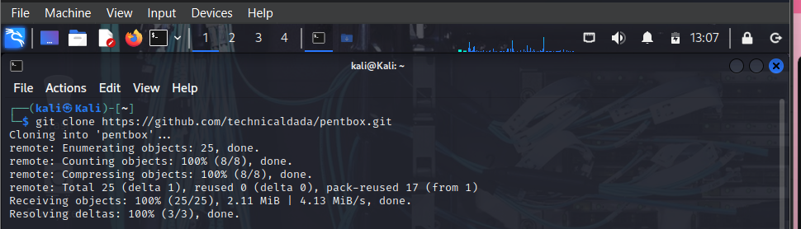
Part 3: using pentbox or any other tool create a honeypot
OBJECTIVE:
To simulate vulnerable systems that attract attackers, allowing security professionals to study attack patterns, monitor malicious activity, and improve defenses.
Step 1: Install a Pentbox
Git clone https://github.com/technicaldada/pentbox - Uses git clone to download the PentBox repository from GitHub

Slide 12
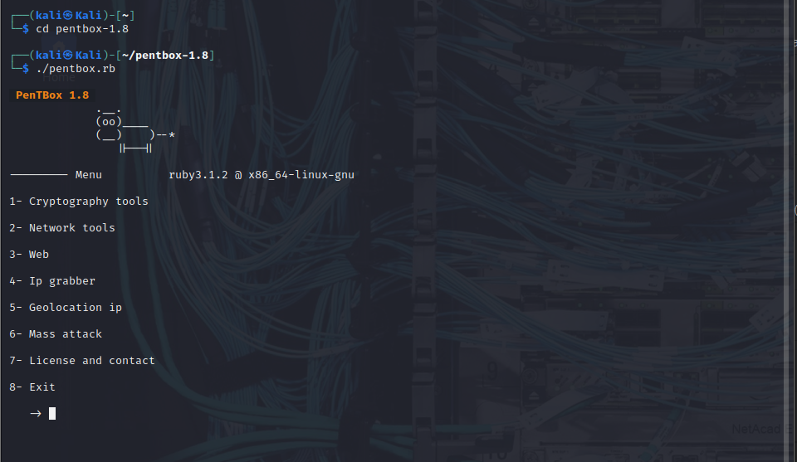
Cd pentbox – Changes the directory cd to the PentBox folder, allowing access to the downloaded files.
STEP 2 : Run the Pentbox
Select option 2 (Network tools)

Slide 13
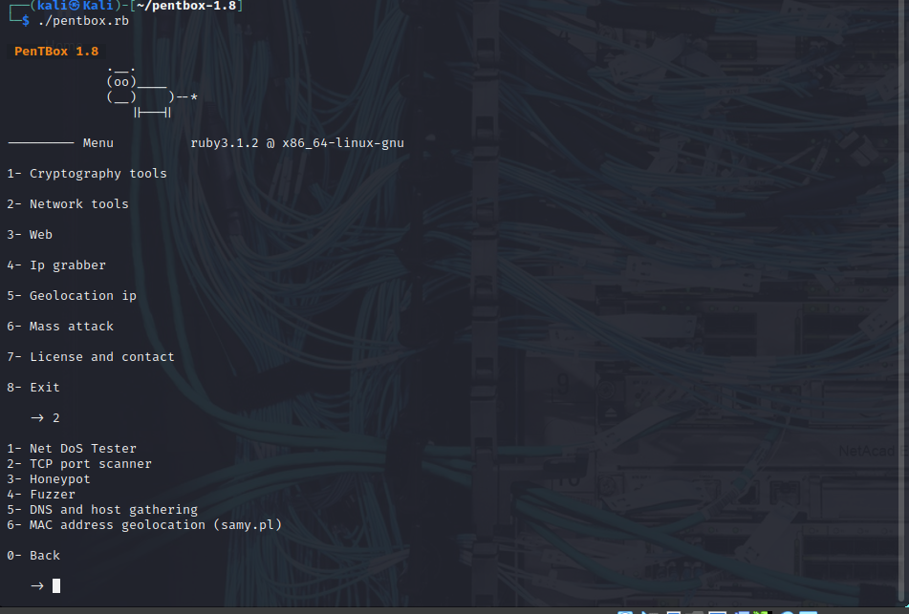
STEP 3: Create a Honeypot
Select Option 3 (Honeypot)

Slide 14
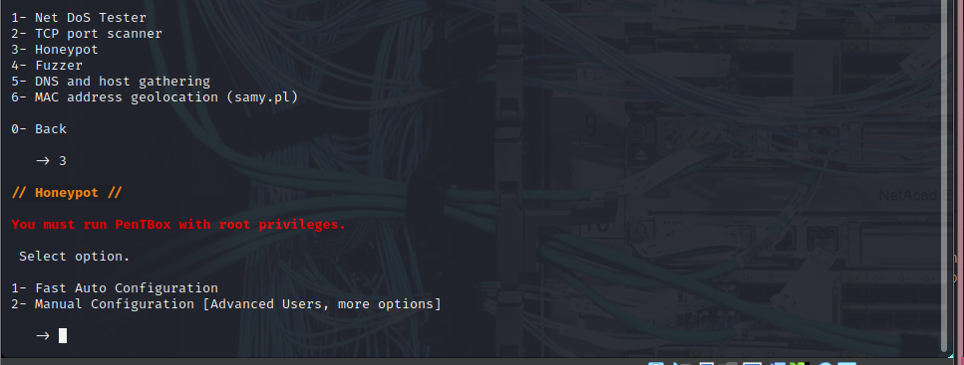
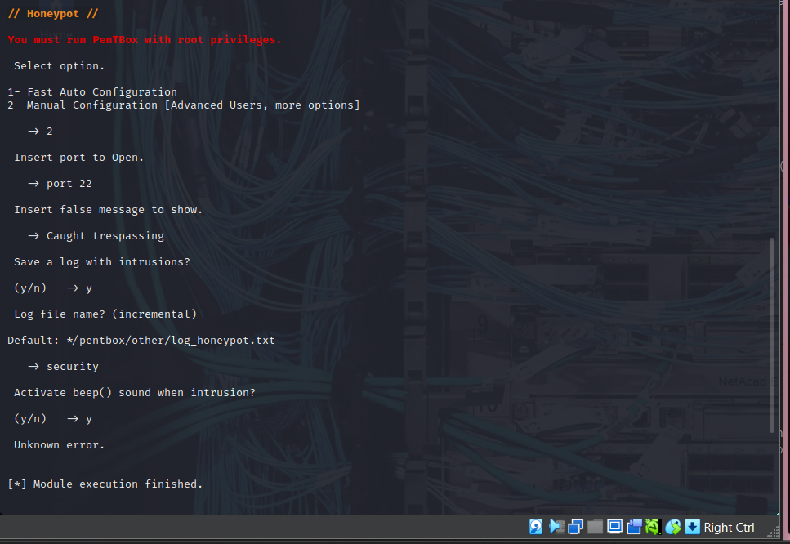
Select Option 2 (Manual configuration)
STEP 4: Activate rules on port 22 and port 80

Slide 15
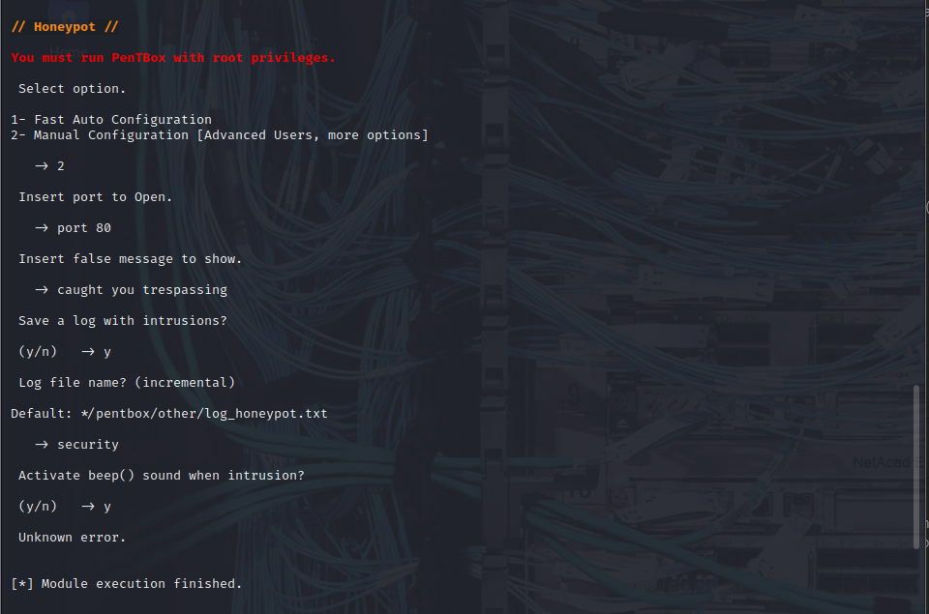
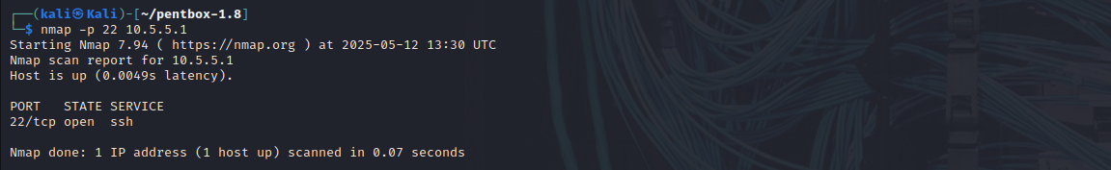
Step 5: Test the Honeypot

